Slide 1

ALY 6140: Capstone Project
Phishing URL Detection Using
Machine Learning
Team Members: Dhruv Patel, Veera Venkata Koushik Kumar Sirigiri, Sai Varma Alluri
Instructor: Prof. Shaiyan Keshvari

Slide 2
CONTENTS
Introduction and Project Overview
Descriptive Analysis
Methodology
Exploratory Data Analysis (EDA)
Model Performances
Key Findings
Recommendations
Conclusion
References

Slide 3
Introduction and Project Overview
Objective: Use machine learning to identify phishing URLs in order to improve cybersecurity and stop data breaches.
The Key Issue: "How accurately can we detect phishing URLs using machine learning models?"
Approach: applied feature extraction, preprocessed the data, and assessed several models, such as SVM and Random Forest.
Importance: Protecting consumers from identity theft, financial loss, and cyber risks is made possible by effective phishing detection.

Slide 4
Descriptive Analysis
Dataset Overview:
Total Samples: 662,591 URLs
Feature Examples: NumDots, UrlLength, AtSymbol, PathLevel
Class Distribution: Approximately 80% legitimate URLs, 20% phishing URLs
Key Insights:
Phishing URLs often exhibit unusual characteristics, like long lengths and use of special characters.
The dataset is imbalanced, reflecting real-world scenarios where phishing attempts are fewer but impactful.

Slide 5
Methodology
Data Collection & Preprocessing:
Sourced data with 662,591 URL samples.
Preprocessing Steps: Removed null values, scaled features, applied log transformation.
Feature Engineering:
Enhanced features such as URL length, number of suspicious characters, and HTTPS presence by normalizing
Model Selection:
Compared performance of Logistic Regression, K-Nearest Neighbors (KNN), Naive Bayes, Decision Tree, and Random Forest.
Training-Testing Split: 70% training, 30% testing with stratified sampling.

Slide 6
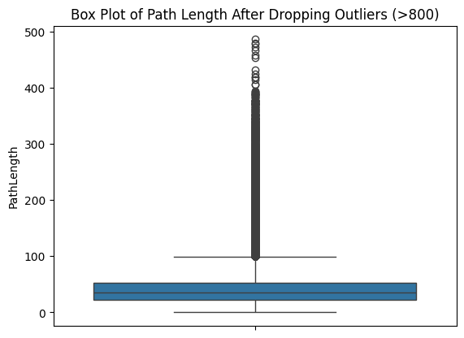
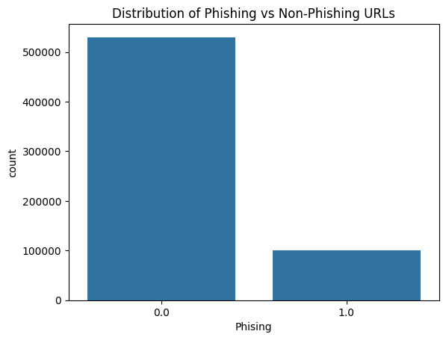
Exploratory Data Analysis (EDA)

Slide 7
The histogram indicates that phishing URLs are typically lengthier.
A bar chart that shows the greater frequencies of special characters ("@" and "%") in phishing URLs is an example of character analysis.
A comparison bar chart shows that phishing websites frequently don't have HTTPS protection.
Weak individual feature correlations were displayed in the correlation matrix, indicating the significance of combined features.
Overview of EDA

Slide 8
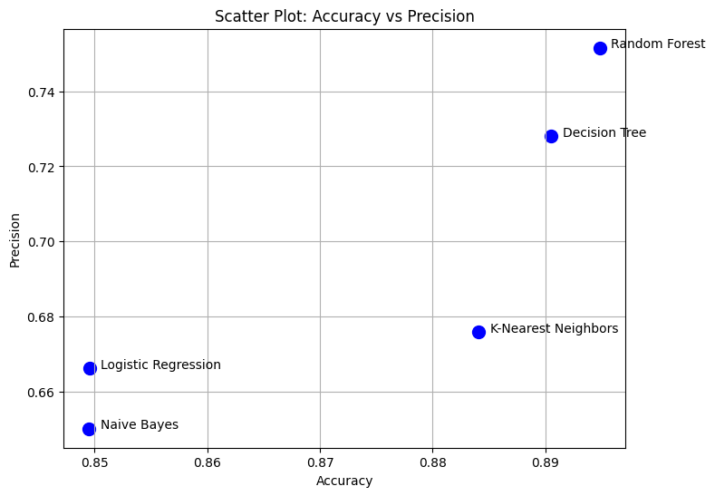
Model performances:
Random Forest is the best performer, excelling in both accuracy and precision.
Decision Tree and KNN are good alternatives, with KNN achieving higher accuracy but lower precision

Slide 9
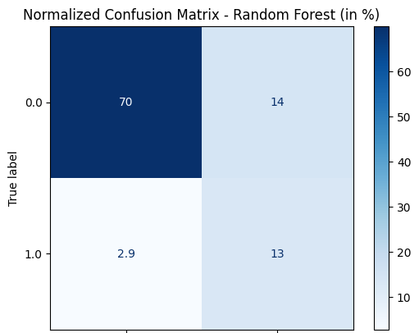
Result Evaluation
83% of data is correctly classified
14% of the total predictions are phishing URLs that were incorrectly classified as non-phishing (false positives)

Slide 10
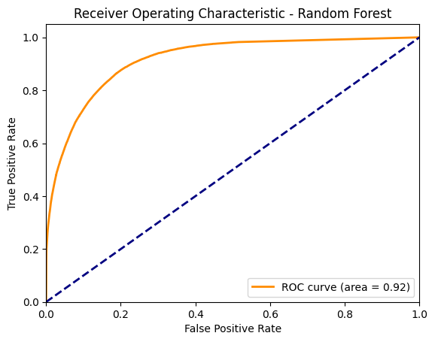
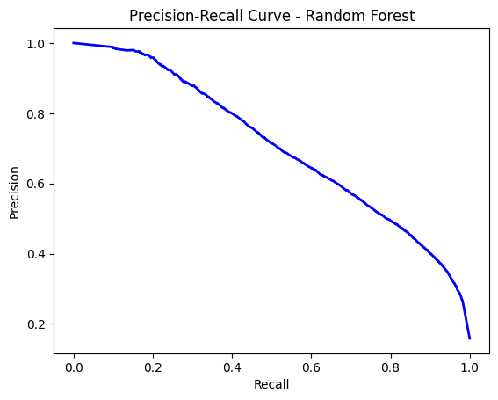
An AUC of 0.91 means that the model has a very good ability to distinguish between the two classes. ,
This means the model is catching more of the phishing URLs, but at the cost of also wrongly predicting some safe URLs as phishing.

Slide 11
Key findings
Random Forest is the most effective model, with the best accuracy and AUC (0.91).
Important characteristics:
URL Length: Phishing frequently uses longer URLs.
Phishing URLs often contain special characters.
HTTPS Presence: Phishing may imitate HTTPS, but legitimate URLs usually use it.
Ensemble models are the most effective at capturing the intricate, non-linear patterns found in phishing URLs.

Slide 12
Recommendations
Feature Engineering: Examining subdomain usage, path structures, and domain names in further detail. For additional information, looking at lexical analysis of URL content.
Advanced Techniques for Ensembles: Try using Gradient Boosting and XGBoost for better prediction, and for increased accuracy, combining Random Forest with other models.
Real-Time Detection: To adjust to changing phishing techniques, using real-time retraining and to guarantee efficiency, regularly checking the model's performance.

Slide 13
Conclusion
With Random Forest appearing as the best performer, our investigation shows that machine learning models may greatly improve the detection of phishing URLs. Its capacity to strike a balance between robustness and high accuracy emphasizes how crucial it is to choose the best algorithm for this task. The model's performance was largely driven by key features that highlighted important signs of phishing attempts, such as the length of the URL and the inclusion of suspicious characters.

Slide 14
References
Alshboul, R. A., Almomani, A., & Al-Kasasbeh, A. (2021). Phishing website detection using machine learning. Journal of Information Security and Applications, 59, 102808. https://doi.org/10.1016/j.jisa.2021.102808
Chiew, K. L., Tan, C. L., Wong, K. Y., & Yong, K. S. C. (2019). A new hybrid ensemble feature selection framework for machine learning-based phishing detection system. Information Sciences, 484, 153-166. https://doi.org/10.1016/j.ins.2019.01.046
Gupta, B. B., Tewari, A., Jain, A. K., & Agrawal, D. P. (2017). Fighting against phishing attacks: State of the art and future challenges. Neural Computing and Applications, 28(12), 3629-3654. https://doi.org/10.1007/s00521-016-2275-y
Mohammad, R. M., McCluskey, T. L., & Thabtah, F. (2014). Predicting phishing websites using classification mining techniques with experimental case studies. Proceedings of the IEEE International Conference on Intelligence and Security Informatics, 4(1), 12-22.

Slide 15
Thank you!

